Slide 1
Volatility as an Asset Class
Update 2
MGT-411
Team Members: Gregory Giordano, Vincent Cortese, Matthew Selvaggi, Scott Caratozzolo, John Tartaglia
Advisor: Hamed Ghoddusi

Slide 2
Overview
Updated research question and method
Volatility trading and dispersion overview
Relevant Literature
Data analysis
Naïve Dispersion Implementation
Index/ETF implementation potential
Planning our next steps

Slide 3
Research Question and Method
Research Question: How can option volatility be used to help generate uncorrelated returns for an investor’s portfolio?
Method:
Download option data from Bloomberg
Implement option volatility trading strategy (Dispersion) in Python
Design ETF/Index that tracks performance of strategy
Analyze how ETF performance can add diversification and uncorrelated returns to a variety of portfolios

Slide 4
Volatility Trading Terminology
Implied Vol
Option Trading
Dispersion (explain exactly what constituents are versus index)

Slide 5


Volatility Trading
Option trading is just another way to trade volatility since volatility is an input for option pricing
Volatility Trading
Options Trading
ViX Trading
Dispersion Trading
Skew Trading
Insert tree diagram
Index Variance
Implied Avg. Correlation

Slide 6
Dispersion Trading
Insert tree diagram
Dispersion
Index Vol elevated compared to Constituent vol
Constituent vol elevated compared to index vol
Long constituent straddles
Short Index straddles

Slide 7
Literature Overview: Volatility as an Asset Class

Slide 8
Literature Overview: Dispersion Trading

Slide 9
Literature Overview: Other Resources

Slide 10
Data Analysis

Slide 11
Naïve Dispersion Implementation

Slide 12
ETF/Index Analysis

Slide 13
Conclusion

Slide 14
Dispersion Trading
Dispersion trading is designed to capitalize on the overpricing/underpricing of index options relative to individual options
Sell options on index and buy options on individual options (delta neutral straddles)
Can be implemented using market ETFs and sector ETFs
Strategy makes money when realized volatilities on individual stocks are high and realized vol on index is low (or vice versa)
Want to find times of high implied correlation or low implied correlation
High correlation indicates implied index vol is elevated (shown in index variance formula below)
Index Variance
Implied Avg. Correlation

Slide 15
Dispersion Trading Continued
Implementing dispersion trades can be done in a variety of ways:
Analyzing implied vs realized correlation changes
Looking for optimal subset of component stocks/ETFs to buy/sell
Different weighting combinations (vega neutral, gamma neutral, or theta neutral at start)
Profits are derived from the relationship between realized volatility and implied volatility
Must analyze the cost of implementing trades
Straddles are expensive
Dynamic delta hedging can increase price as well

Slide 16
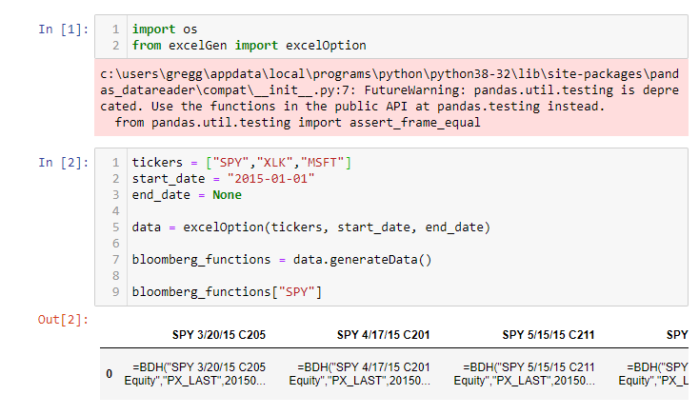
Data Collection Update
Currently, we have a Python class “excelOption” that can create the excel file we need to download any option data in Bloomberg
Next step is to download the generated data in Bloomberg to read back into Python to analyze trading strategies

Slide 17
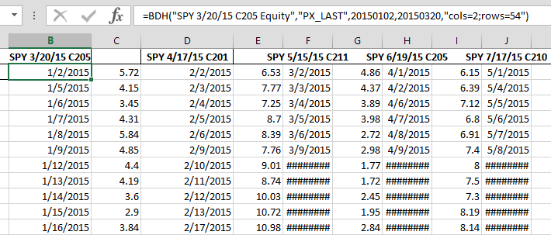
Data Collection Continued
When Excel file generated in Python is opened with Bloomberg Excel Add-In, historical option data for all tickers is generated

Slide 18
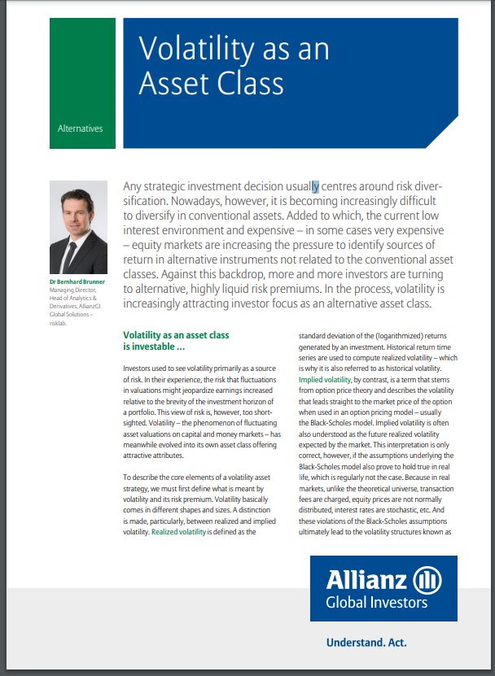
Portfolio Implementations
How can we implement a dispersion trading strategy in any investor’s portfolio?
Returns and diversification benefit
Shift focus to pitching an ETF or index that tracks the returns of a dispersion trading strategy.
Enables a lot of capital to implement the strategy
Access of dispersion to all types of investors
Need to consider annual ETF expenses
Allianz Global Investors created the VPT index that tracks selling volatility via variance swaps to give investors access to volatility as an asset class
Use Allianz’s model to create our own index/ETF

Slide 19
Next Steps
Possible Challenges and Risks
Begin implementing dispersion backtest
Build on class that generates Excel File
Try different dispersion implementation strategies
Work through cleaning data
Missing dates and illiquidity is an issue with option data
Incorporate volume into our model
Utilize bid/ask spreads if data is available through Bloomberg
Continue research on how volatility can add benefits to investor portfolios
How to compute/quantify diversification benefits
Explore further Skew Trading strategies to eventually implement
Notes:
Create a clear tree presentation to show why things are going to work, gives structure of which things are going to test.
Nov 9, touch base

